Slide 1





Regent Education and Research foundation
Prepared by :
Rishita Ghosh (26371023033)
Ranjan Khan (26371023032)
Mentor: Ms. Riddhika Basu

Slide 2
Project on
LIBRARY MANAGEMENT SYSTEM

Slide 3
List of contents
Introduction
Flowchart interface
Objective
Software version and cost
Product function
Summary
User Classes
Assumption
Solution of the problem

Slide 4
Introduction
A Library Management System (LMS) is a software application designed to automate and streamline various library operations, making them more efficient and effective. It helps manage the library's collection, circulation, cataloging, and other functions, offering benefits like reduced manual labor, improved record-keeping, and faster access to information for both librarians and patrons.

Slide 5
Objective
1. It provides better and efficient service to members
2. Reduce the workload of librarian
3. Faster retrival of information about the desired book
4. Provide facility for proper monitoring reduce paper work and provide data security
5. All details will be available on a click for both user and librarian

Slide 6
Project Scope
Many libraries are operated manually by a group of people. These people keep records regarding the books & students (borrowers), check the book manually and keep records on issued books. All these things have to be carried out manually and if the library is very large, proper record keeping will become a major problem as manual record keeping has never been a reliable method because people tend to forget things.

Slide 7
Solution of the Problem
The solution to the problem of the manual library management is to develop a computerized library management system. Before developing the proposed system, there is need to identify:
The design of the proposed system
The main users of the library management system The activities of the main users

Slide 8
Assumptions
➤ Fast report generation is not possible
➤ Tracing a book is difficultOther problems of the existing system are:
➤ Information about issue/return of the books is not properly maintained
➤ No central database can be created as information is not available in database

Slide 9
Product Functions
Activities of the Borrower / Student | Activities of the Admin
Search for a book | Issue book
Borrow a book | Return book
View User details | Add/ Deelete book
User details modify

Slide 10
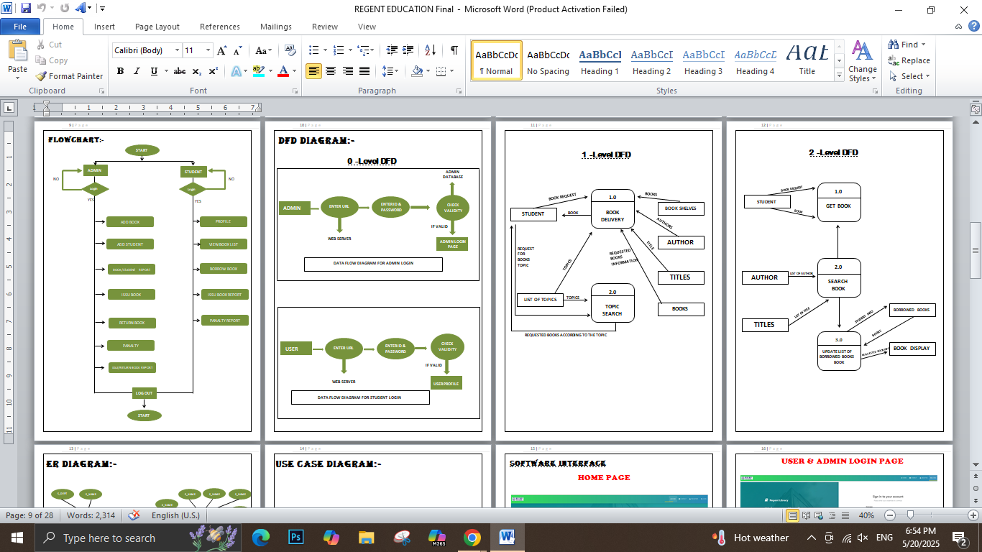
Flowchart

Slide 11
0-Level DFD

Slide 12
1-Level DFD

Slide 13
2-Level DFD

Slide 14
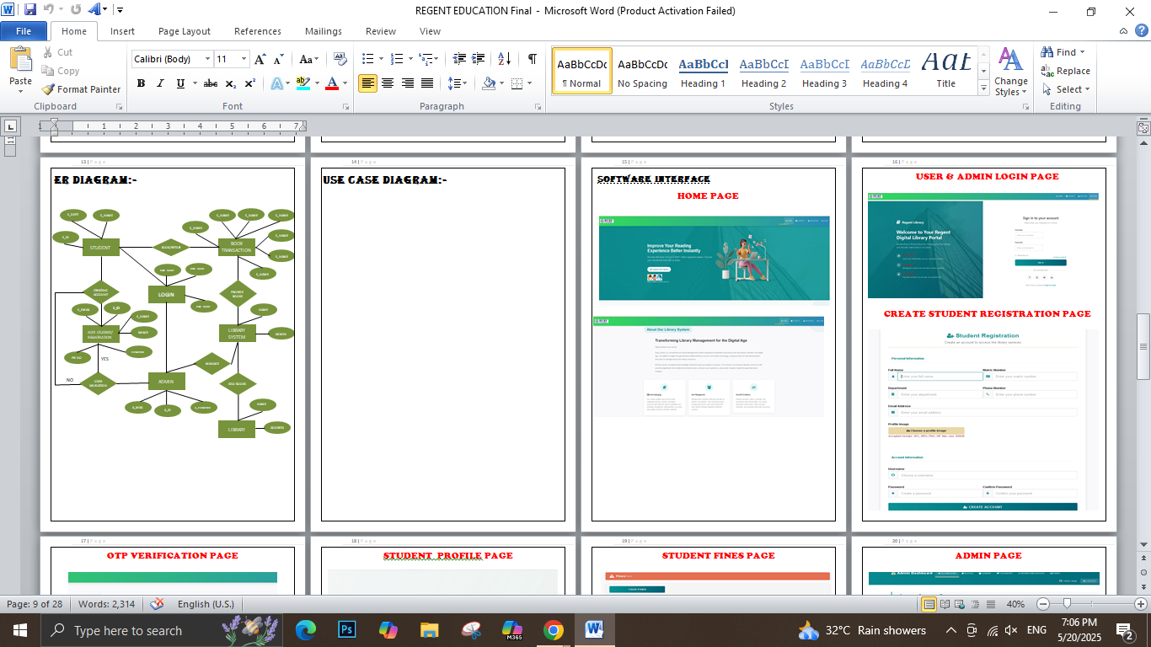
ERD

Slide 15
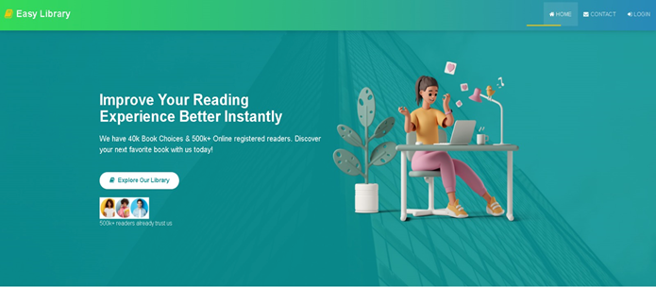
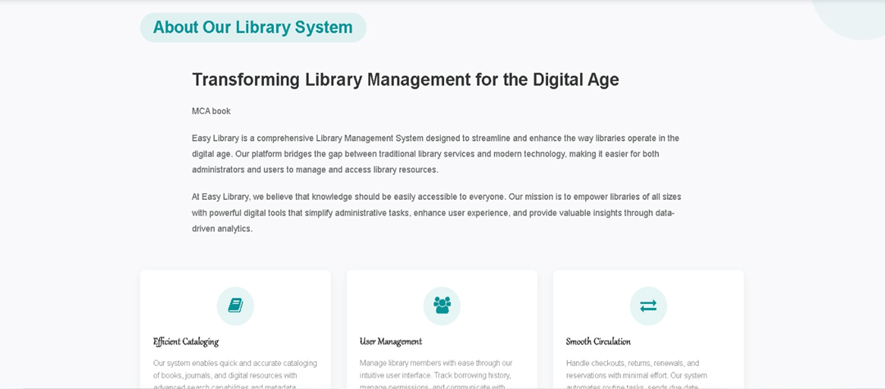
HOME PAGE

Slide 16
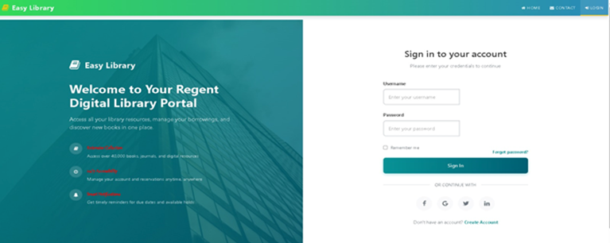
USER & ADMIN LOGIN PAGE

Slide 17
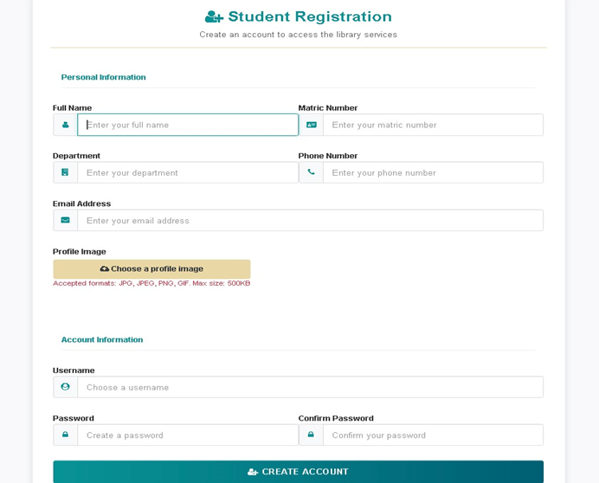
CREATE STUDENT REGISTRATION PAGE

Slide 18
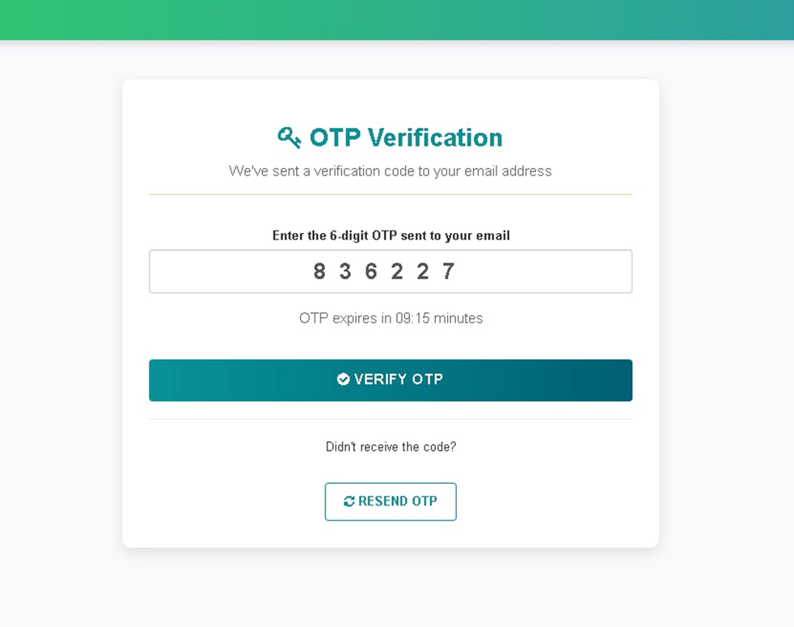
OTP VERIFICATION PAGE

Slide 19
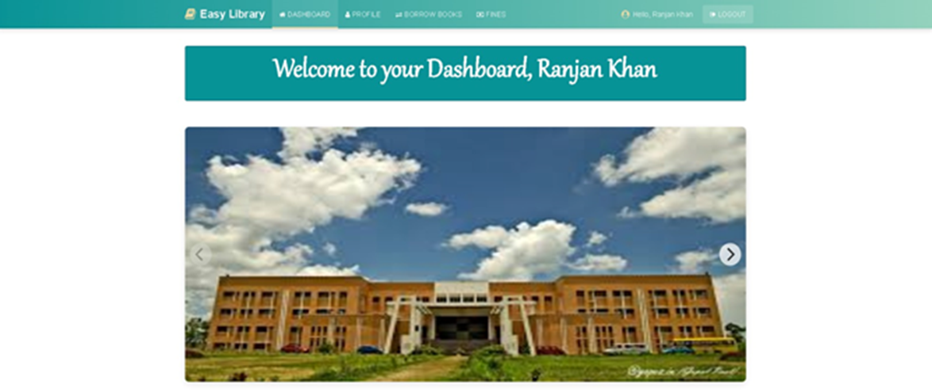
STUDENT PORTAL PAGE

Slide 20
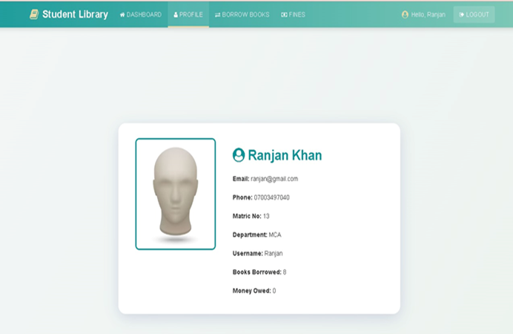
STUDENT PROFILE PAGE

Slide 21
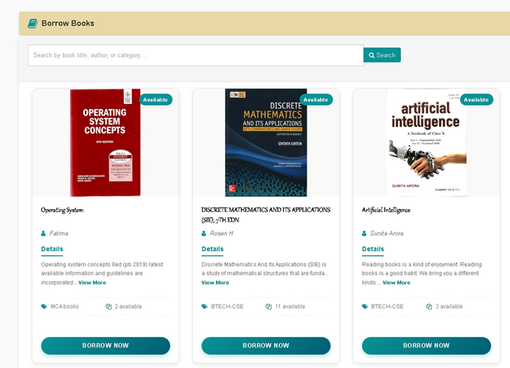
BOOK BORROW PAGE

Slide 22
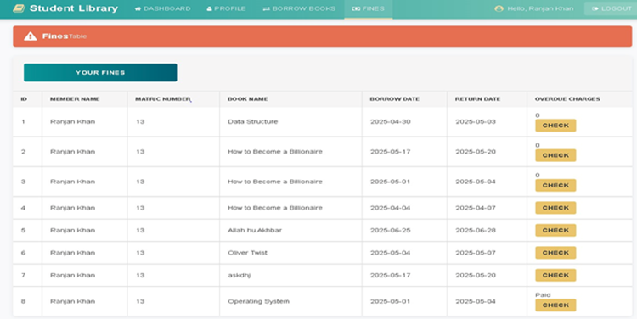

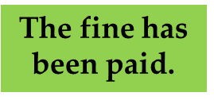
STUDENT FINES PAGE

Slide 23
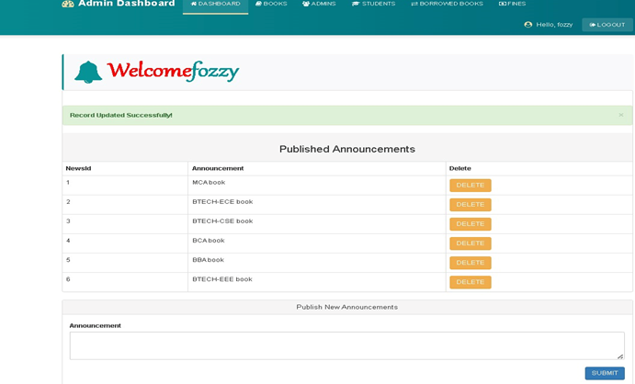
ADMIN PAGE

Slide 24
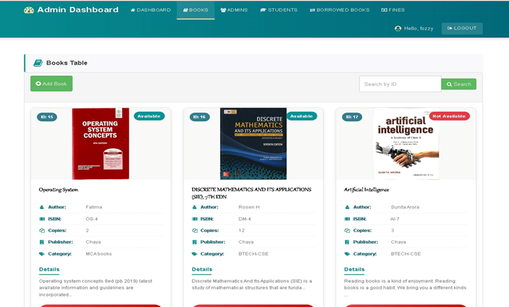
BOOKS TABLE PAGE

Slide 25
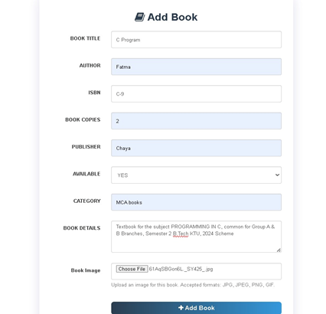
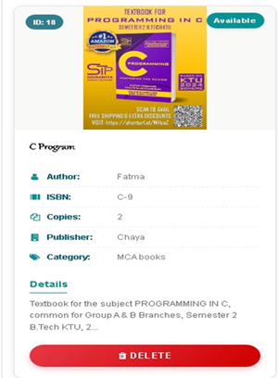

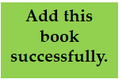
ADD BOOK PAGE

Slide 26
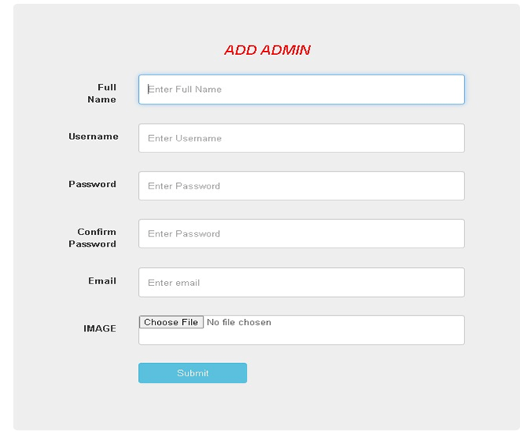
ADMIN ADD PAGE

Slide 27
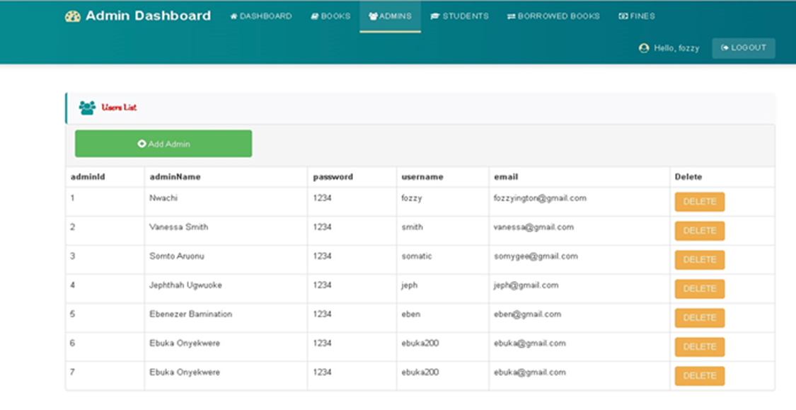
ADMIN ADDED PAGE

Slide 28
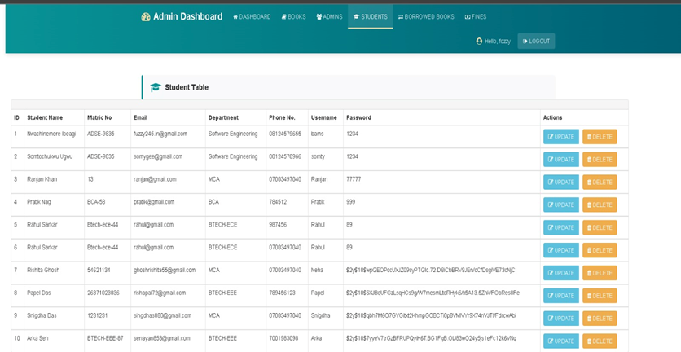
ADD STUDENT BY ADMIN PAGE

Slide 29
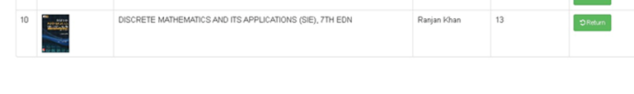


BOORED BOOK IN ADMIN PAGE

Slide 30
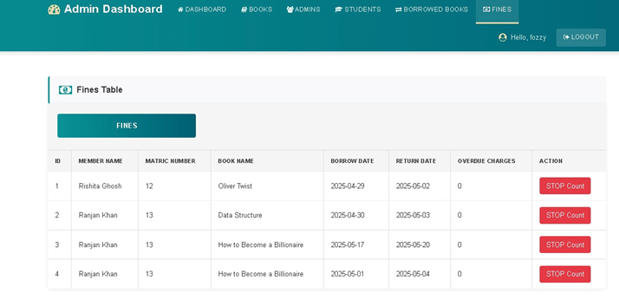
ADMIN FINES PAGE

Slide 31
Thank You

